Slide 1
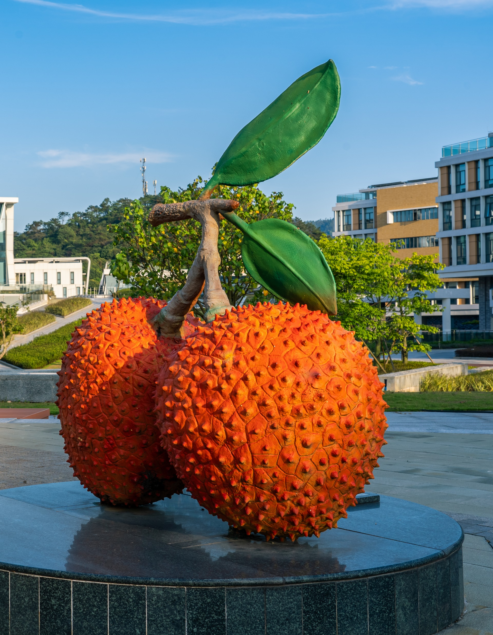
Faculty of Science and Technology
Minor Programme

Slide 2


CONTENTS
01
FST Minor Programmes
02
Who Is This For?
03
What You Will Learn
04
Programme Requirements
05
Questions & Contact

Slide 3
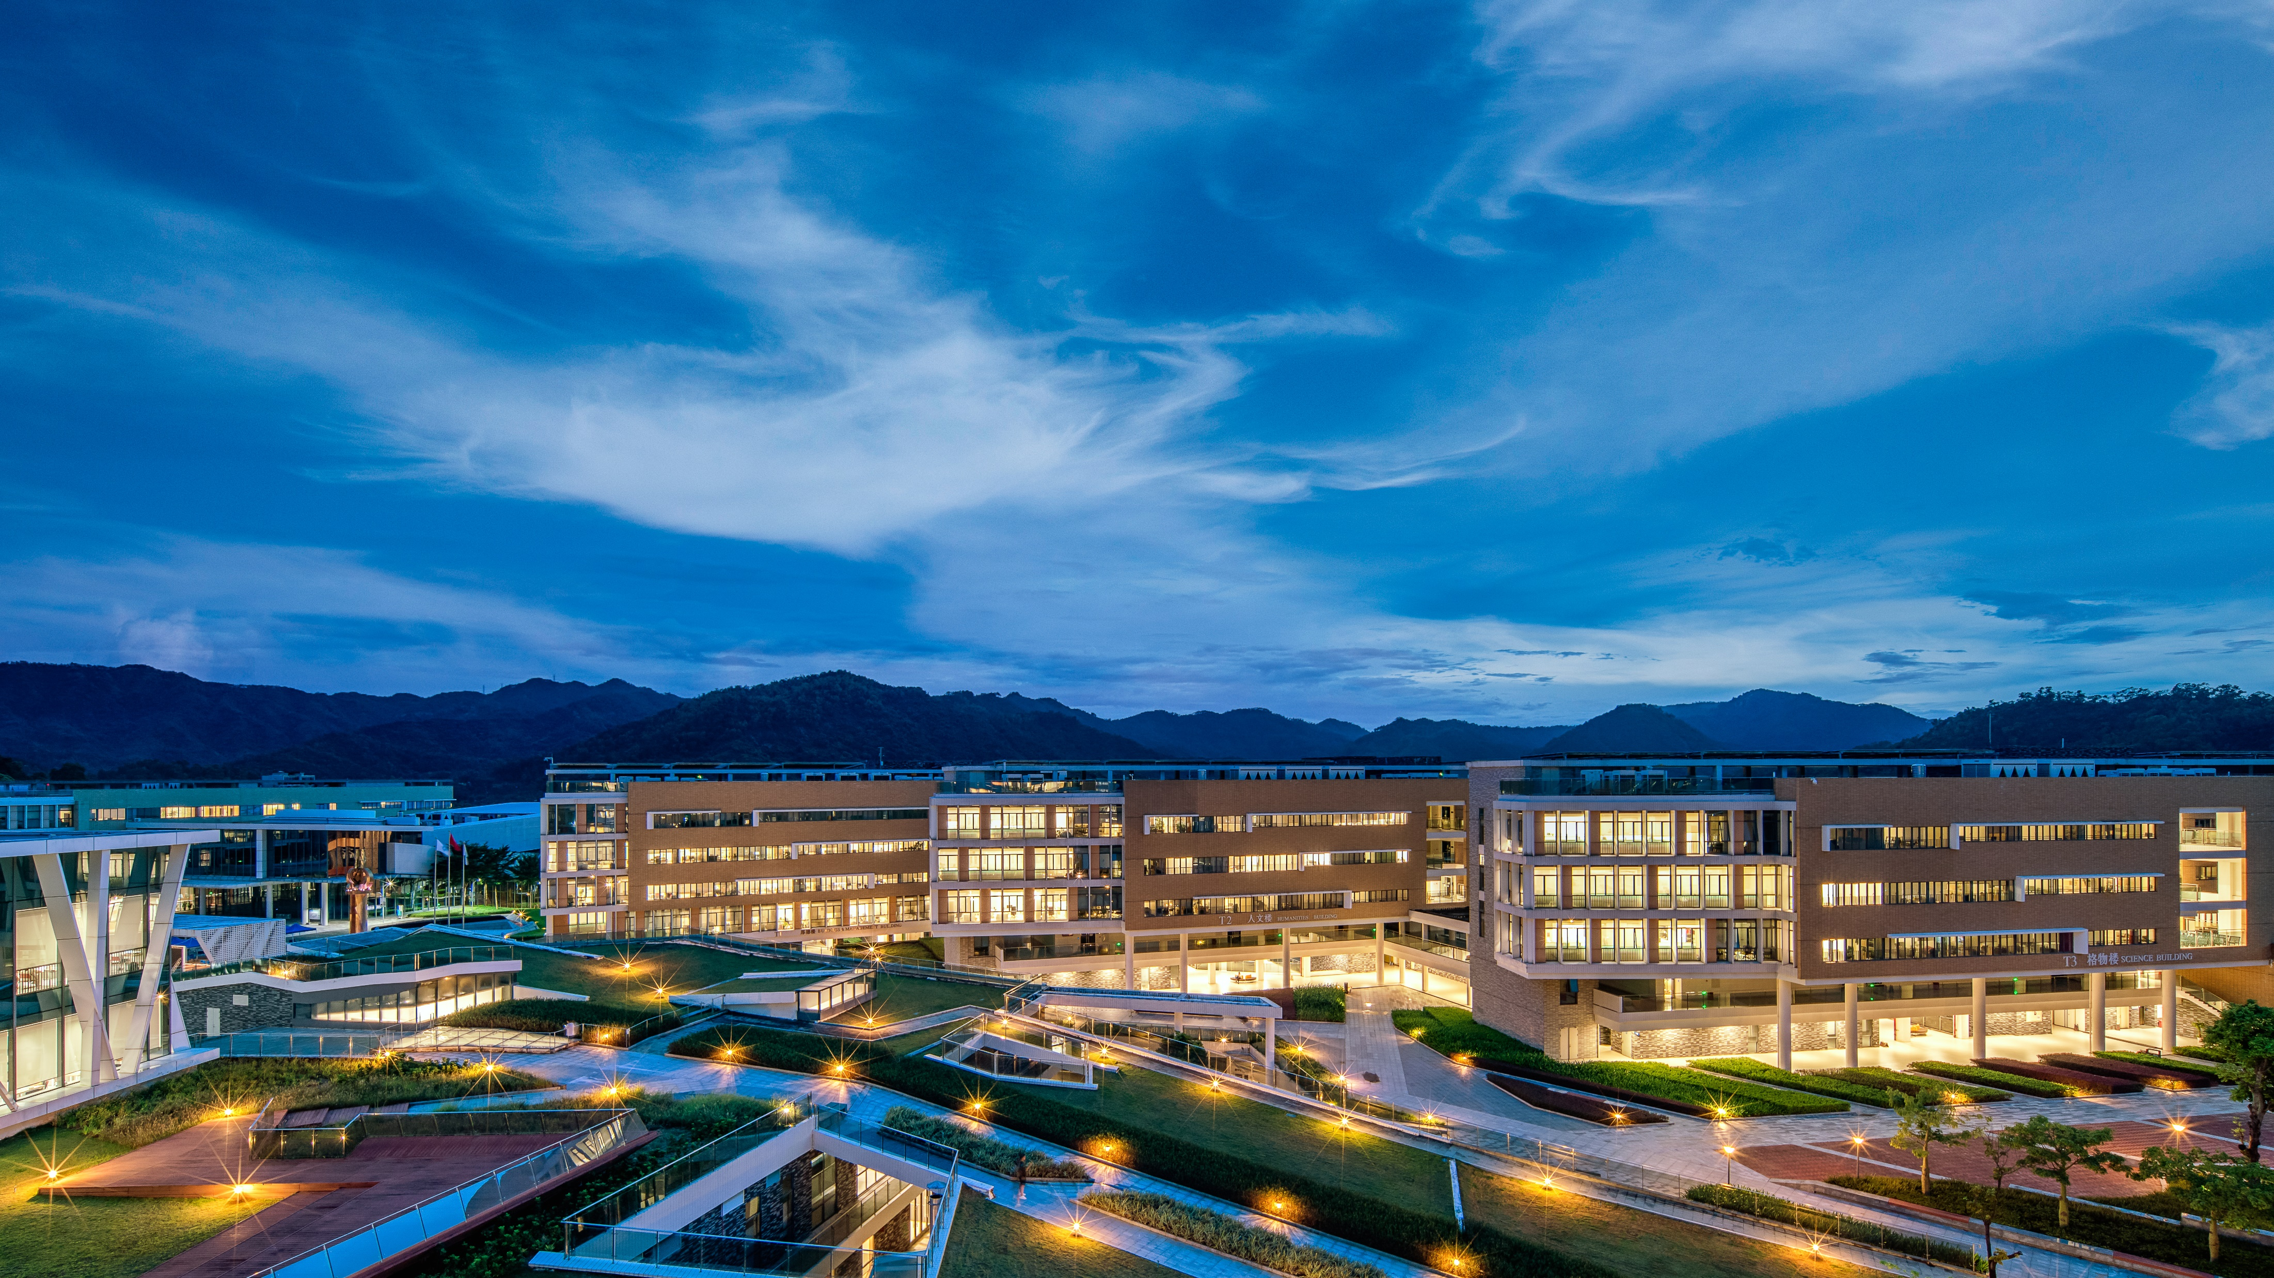
FST Minor Programmes
Part 01

Slide 4
FST Minor Programmes
Minor Programme in Environmental Sustainability and Management
3
Minor Programme in Applied Psychology
1
Offered by ENVS
Offered by APSY
4
Minor Programme in Nutrition and Global Health
Minor Programme in Computer Science and Technology
2
Offered by FS
Offered by CST

Slide 5
Who Is This For?
Part 02

Slide 6
Target Students
Minor in APSY
All non-APSY students
应用心理学副修
For students with a foundation in math and programming, excluding AI, CST, and DS progrmmes.
Minor in CST
计算机科学与技术副修
Minor in ESM
All non-ENVS students
环境可持续性与管理副修
75%
Minor in NGH
All non-FS students
营养及全球健康学副修
PPT下载 http://www.1ppt.com/xiazai/

Slide 7
What You Will Learn
Part 03

Slide 8

Minor in APSY
The Interdisciplinary Edge
A Minor in Applied Psychology provides rigorous thinking skills and a deep understanding of human behavior, enabling deeper introspection and enhanced performance across all your fields of study.
With a Minor in Psychology, You Will:
Master core psychological principles and methods
Analyze the drivers behind cognition, emotion, and behavior
Decode complex social phenomena through a scientific lens
Enhance emotional intelligence for personal and professional growth
Navigate and resolve interpersonal conflicts effectively

Slide 9

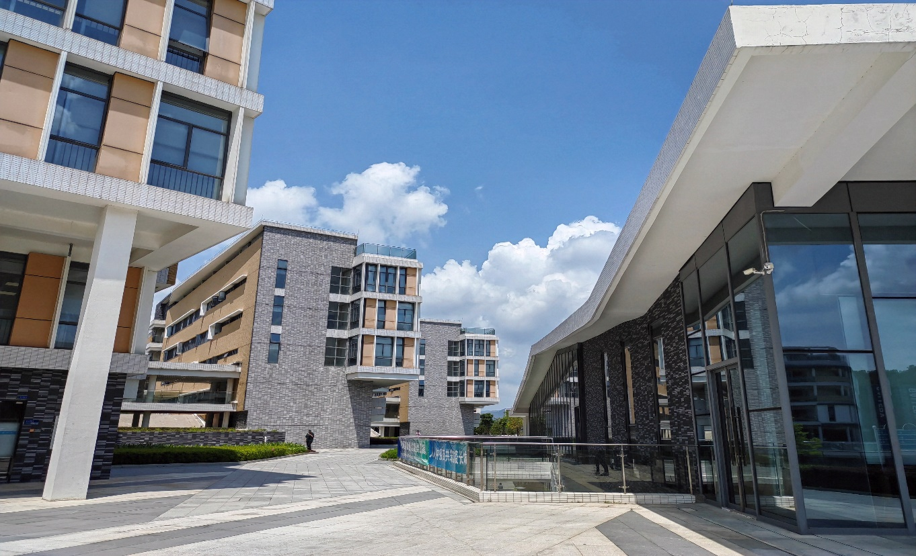
Minor in CST
Why minor in CST?
Elevate your skills from software use to advanced learning and research.
Become a sought-after interdisciplinary talent.
With a Minor in CST, You Will:
Build functional software applications
Acquire practical data analytics skills
Master cutting-edge IT advancements
Collaborate effectively with engineering teams
Gain foundational skills to launch an IT venture

Slide 10



Minor in ESM
Why This Matters:
A Global Priority：On national and international agendas.
An Industry Trend：Central to business now and in the future.
Future-Proof Your Career：Widens career and postgraduate options.
With a Minor in ESM, YOU WILL:
Acquire a robust foundation in sustainable development practices.
Gain the toolkit to implement sustainable strategies in any industry.
Develop a holistic, interdisciplinary mindset for managing complex environmental issues.

Slide 11

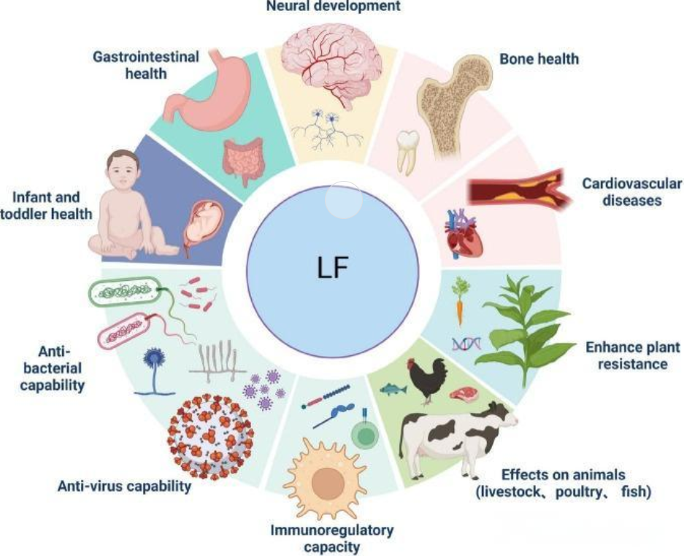
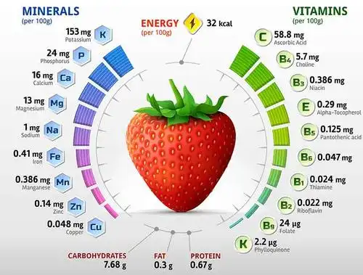
Minor in NGH
What You Will Gain:
Global Awareness of critical health challenges.
Strategic Skills in nutrition and health.
Career Readiness for the healthcare and wellness sectors.

Slide 12
Programme Requirements
Part 04

Slide 13


Minor Programme Requirements
Minor Curriculum Structure
Units
(15)
cGPA
(2.0)
Required /Compulsory Courses
Elective Courses
GPA
Full details:
1
Minor Programme Regulations & Handbook (AR website)
https://ar.bnbu.edu.cn/current_students/minor_programmes/handbook.htm

Slide 14
Questions & Contact
Part 05

Slide 15

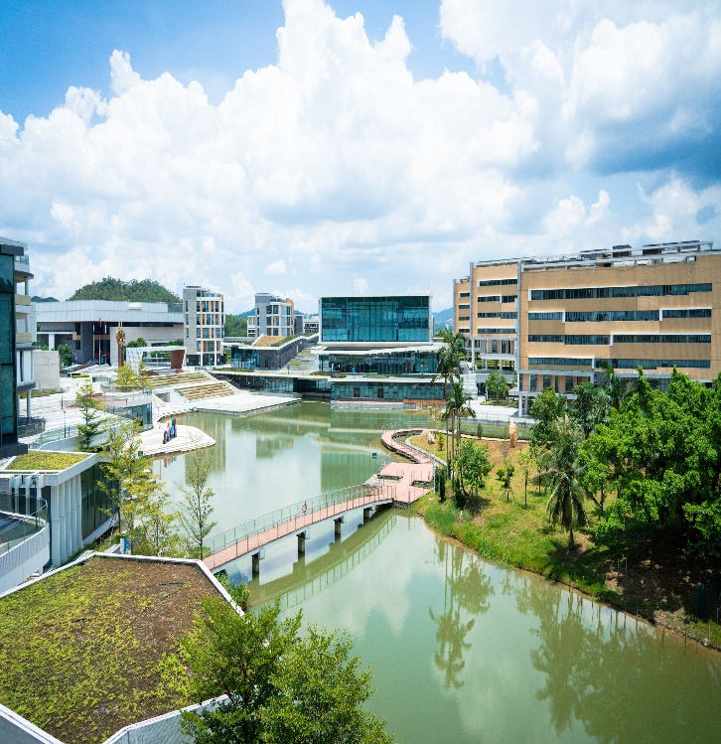

Contact
Ms. Fannie Fang
Email: fanniefang@bnbu.edu.cn
Office: T3-601-R10
Tel: 0756-3620200

Slide 16
THANK YOU

